Slide 1
Effects of Antioxidants on the Survival of C. elegans under Oxidative Stress
Aneesh, Samuel, Sree, Marin
Group 38: Northeastern University
12/2/2022

Slide 2
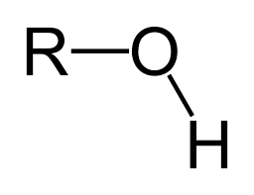
What Induces Oxidative Stress?
Oxidative stress is induced by overproduction of reactive oxygen species (ROS)₁
ROS are highly reactive chemicals
Formed from -O₂ species
https://www.thoughtco.com/definition-of-hydroxyl-group-608739
1. (Ayuda-Durán et al. 2020)

Slide 3
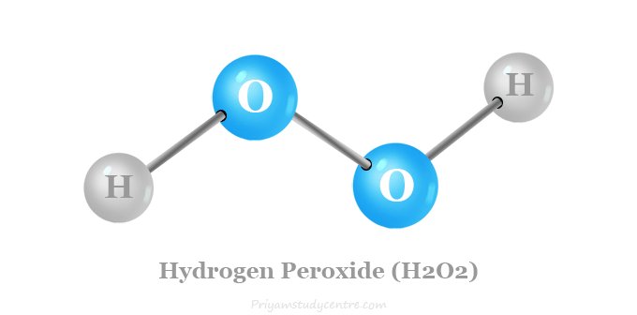
Hydrogen Peroxide was used to induce oxidative stress
Exposure to hydrogen peroxide can induce oxidative stress in cellular organisms₁
We utilized a concentration of 0.1%
Half of plates in survival assay had hydrogen peroxide mixed into agar
https://www.priyamstudycentre.com/2020/03/hydrogen-peroxide.html
1. (Ayuda-Durán et al. 2020)

Slide 4
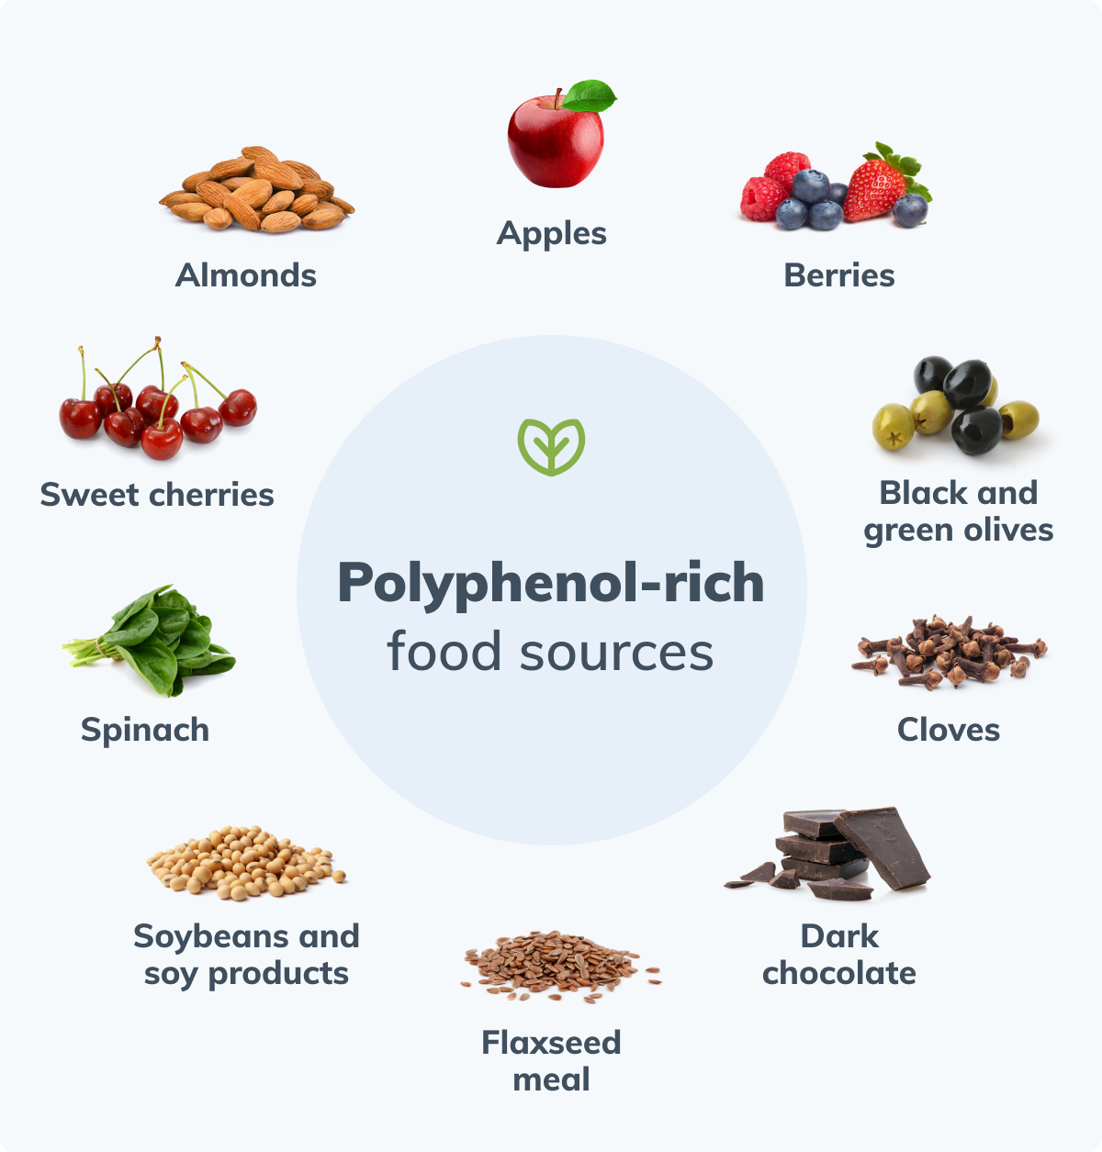
Antioxidants have been known to regulate ROS levels in C. elegans₁
Antioxidants found in food sources can regulate ROS levels
Polyphenols (class of compounds in plants) contribute to resistance of ROS
Mostly found in plants, fruits, grains, etc.
https://fullscript.com/blog/polyphenols
Notes:
Notes:
Polyphenols contain flavonoids
Can favor indirect antioxidant mechanisms
Activate natural antioxidant defenses

Slide 5
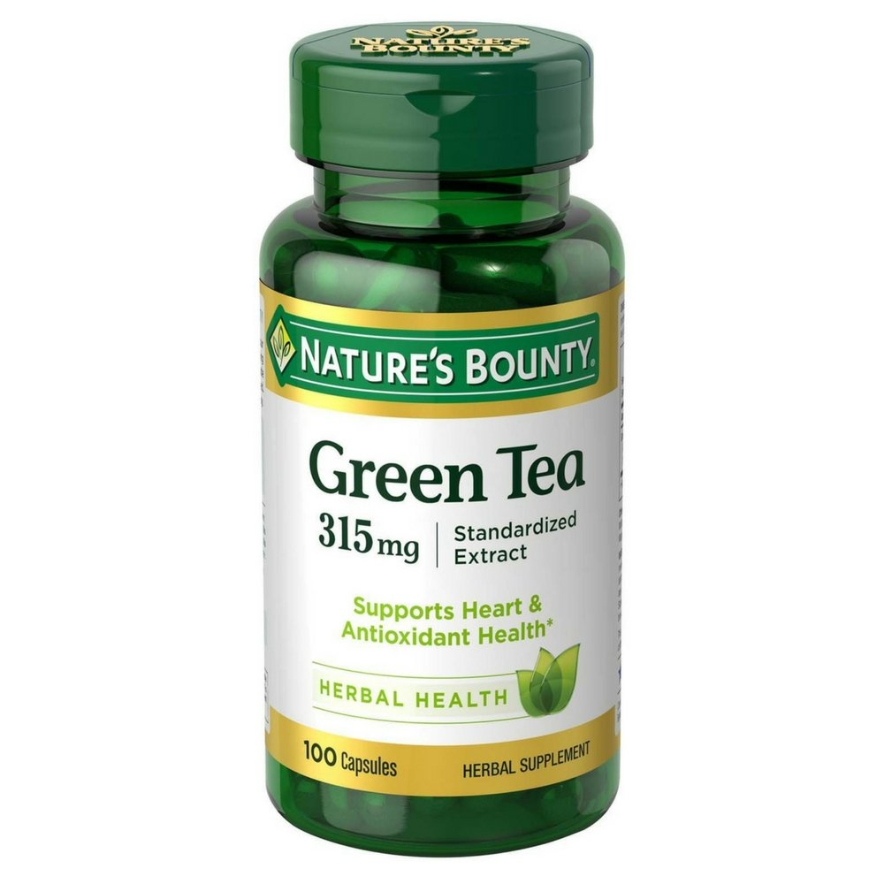
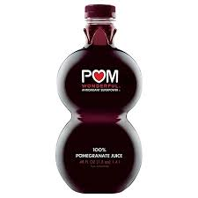
Green Tea and Pomegranate Juice were used as antioxidants to regulate ROS levels
Both contain high levels of antioxidants
Pomegranate Juice contains 3x the amount of antioxidants
3 different concentrations based on polyphenol content
0.1 mg/mL, 0.5 mg/mL, 2.5 mg/mL
Mixed with E. coli OP50 food source
https://www.heb.com/product-detail/pom-wonderful-100-pomegranate-juice/933662
https://www.amazon.com/Natures-Bounty-Green-Extract-Capsules/dp/B01IAI2DGM
1. (Ayuda-Durán et al. 2020)

Slide 6
Research Question: What are the effects of antioxidants on the survival of C. elegans under oxidative stress?

Slide 7
Hypothesis: Antioxidants will prolong the survival and improve the motility of C. elegans under oxidative stress.

Slide 8
Worms get chunked onto new plates
Worms are ready for the next step
Worms get bleached onto new NGM plates
Treatments are made with appropriate concentrations of PJ & GT and liquid culture; treatments seeded onto 7 plates
Worms chunked onto treatment plates
10 worms picked onto each treatment plate
Treatments are made with appropriate concentrations of PJ & GT and liquid culture; treatments seeded onto 14 plates
Intervals are at 30, 60 and 90 minutes after picking
After 20 minutes, thrashing assay occurs; pick out three worms per treatment; identify amount of turns per minute
Over 3, 30 minute intervals, number of alive worms left on each treatment plate are counted and recorded
MOTILITY ASSAY
SURVIVAL ASSAY

Slide 9
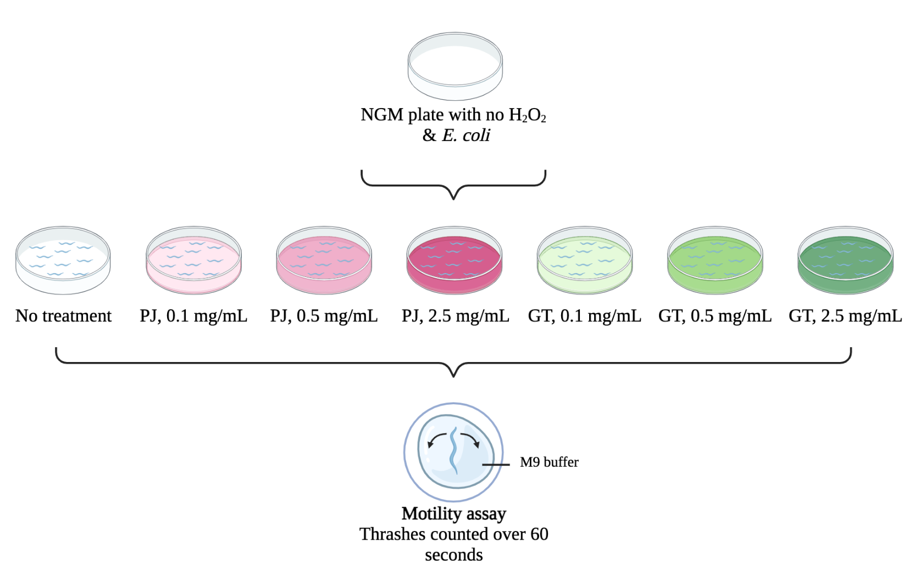
A motility assay was run to examine effects of treatments on movement of worms
H2O2 plates prepared
PJ treatments prepared
GT treatments prepared
Controls: NGM plate & NGM plate with H202, both with only E. coli
10 worms picked onto each plate; motility was counted for 3 worms
Worms left on plates for 4 hours (run 1), then 20 minutes (run 2)
3.) (Somuah-Asante and Sakamoto 2022)
Notes:
EXPLAIN STEPS (Not on slides):
Make NGM/pour plates
Make treatments/seed plates
Pick 10 worms onto each plate
Examine motility after 4 hours/20 minutes (explain why this changed between trials)
Mention that our first motility assay informed the time range for our survival assay

Slide 10
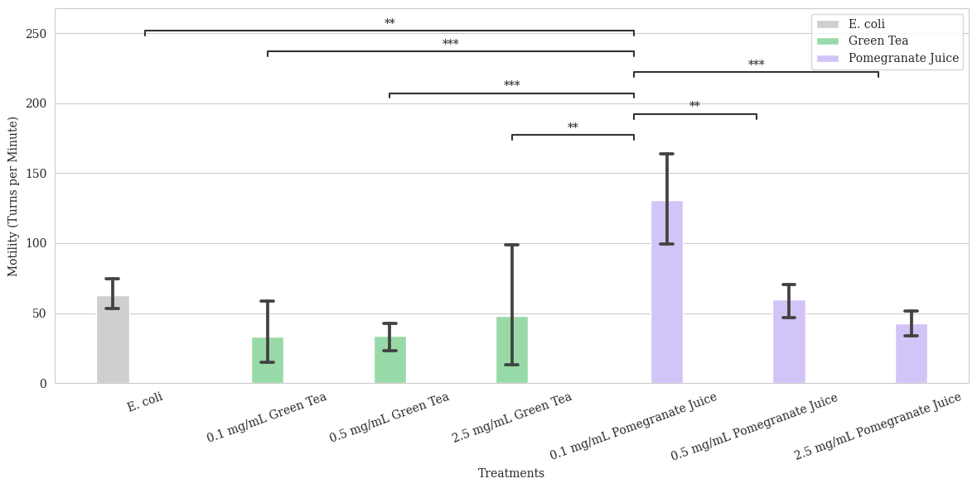
Pomegranate juice at 0.1 mg/mL concentration improves the motility of C. elegans

Slide 11
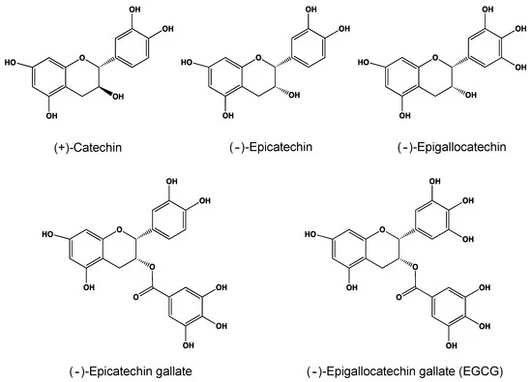
Increase in Motility is concentration dependent
Mixed results for motility of C. elegans under stress
Low concentration of PJ is best
Effects of PJ & GT are concentration-dependent
High concentrations of PJ - negative effects
GT catechins reduce ATP levels for 24 hours
Initial spike of ROS
Notes:
Up to 100 uM tannins helpled; too much detrimental

Slide 12
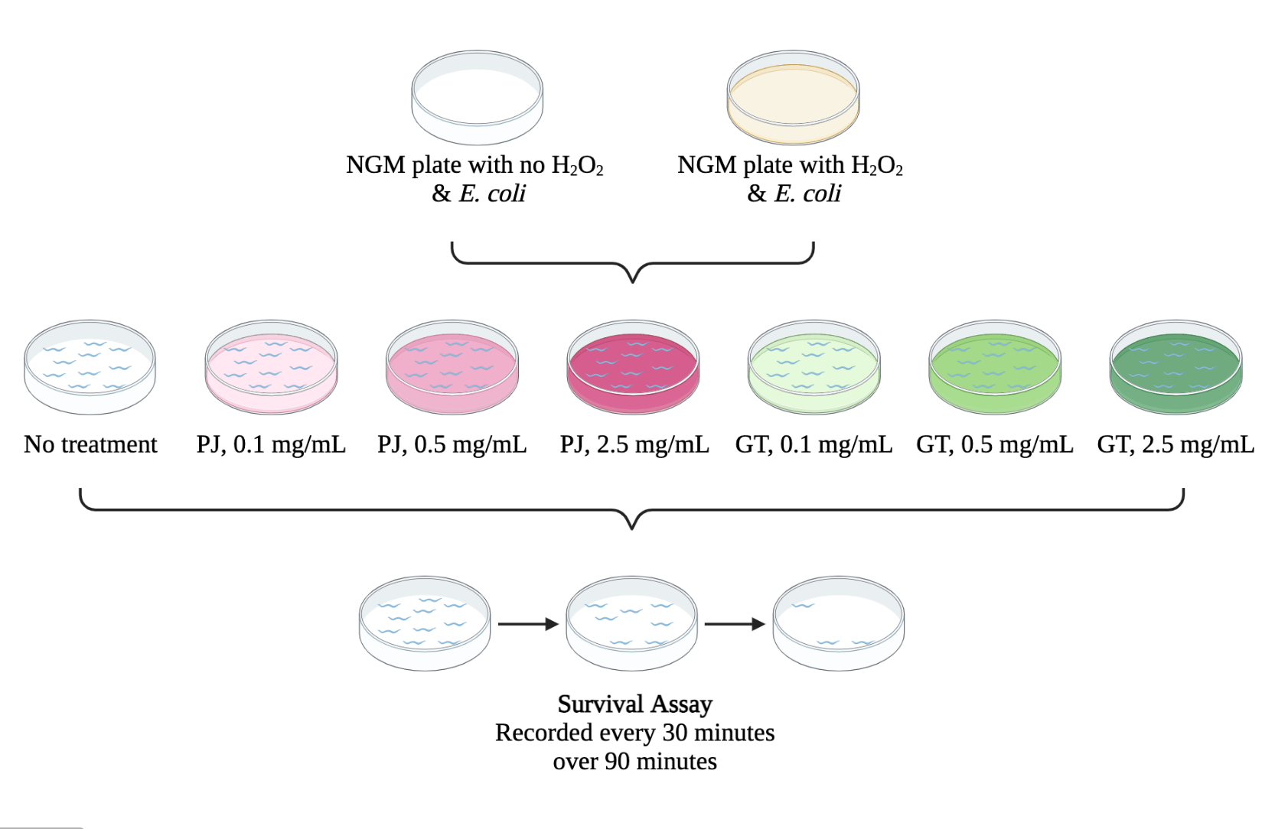
A survival assay was run using three concentrations of each treatment
H2O2 plates prepared
PJ treatments prepared
GT treatments prepared
Controls: NGM plate & NGM plate with H202, both with only E. coli
10 worms picked onto each plate
2.) (Kumsta et al. 2011)
Notes:
EXPLAIN STEPS (Not on slides):
Make NGM (EXPLAIN HOW H2O2 WAS MADE)/pour plates
Make treatments (EXPLAIN HOW)/seed plates
Bleach worms
Pick 10 worms onto each plate
Count live worms every 30 minutes for 90 minutes
Mention that our first motility assay informed the time range for our survival assay

Slide 13
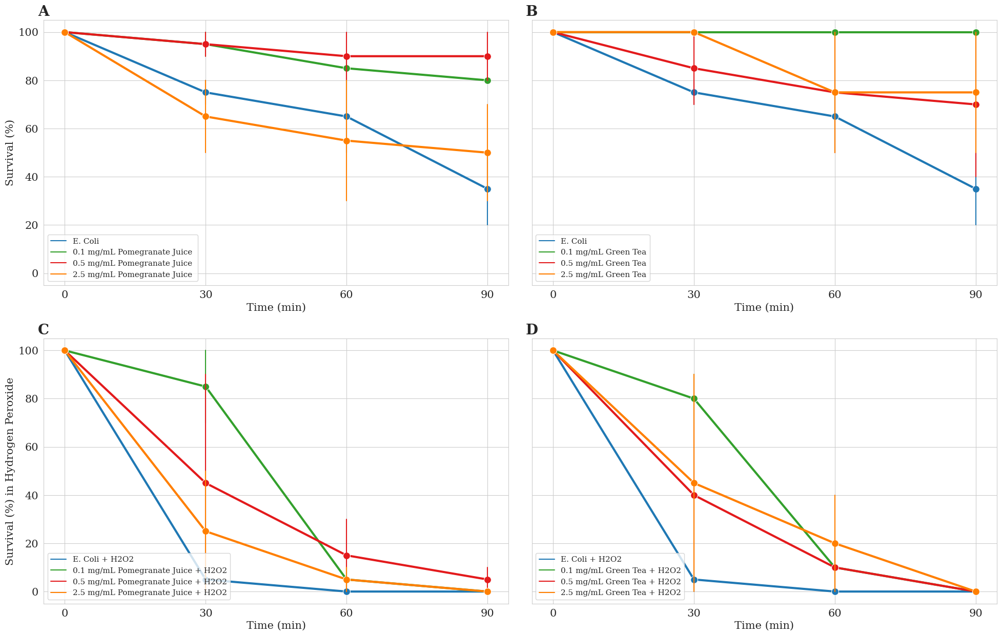
PJ & GT boost the survivability of C. elegans under neutral conditions in a concentration dependent manner

Slide 14
PJ & GT temporarily enhance the survivability of C. elegans under oxidative stress in a concentration dependent manner

Slide 15
Antioxidants may be responsible for the increase in survivability
Enhancement of C. elegans survivability under neutral conditions
High Antioxidant content in PJ & GT
Ability to neutralize ROS in cells of C. elegans
Lower concentration better because of hormetic properties
Temporary enhancement of survivability of C. elegans under stress
Limited supply of antioxidants vs constant supply of H2O2
Notes:
Increase of survival low concentrations of PJ is due to the high antioxidant content of PJ. PJ also consists of other compounds such as sugars, which have a negative effect in organisms when present in abundance.
Vaccine: If an antioxidant intake is too high, the initial spike in ROS levels may be enough to kill the organism
Hormetic properties: characteristic where too much of something can lead to detrimental effects
Because ROS are required to an extent for proper cell functioning

Slide 16
Future experiment to further study the effects of antioxidants
Feed C. elegans isolated antioxidants from PJ & GT
Catechins, flavonoids, tannins
Various concentrations of antioxidants
qPCR to determine transcriptional mechanism in antioxidant defense
Sod-1 gene transcription
Notes:
1). Further reinforce idea that antioxidants increase survivability
2). Various concentrations of antioxidants to gain insight on relationship between conc. of antioxidants and nematode survivability per time
3).Observe up to what concentration of GT Catechins can nematodes handle before killed via Vaccine-like mechanism
4.) qPCR if we have time

Slide 17
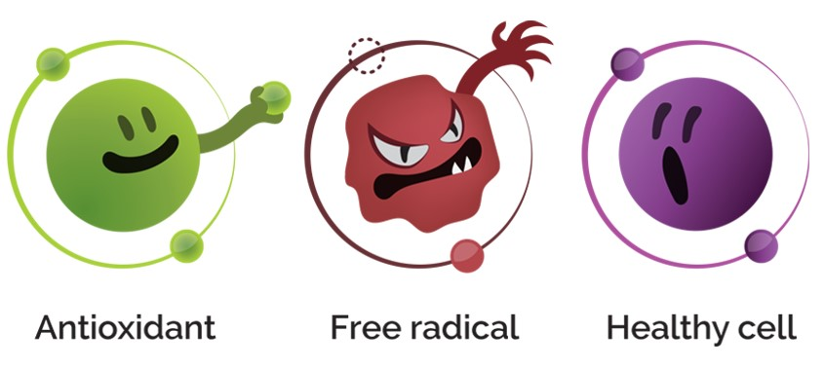
SUMMARY
PJ & GT increase survivability of C. elegans under neutral conditions
PJ & GT temporarily increases survivability of C. elegans under oxidative stress
Both in a concentration dependent manner
Low concentration of PJ improves motility of C. elegans
Hormetic properties of tannins
GT did not change motility
Catechins drop ATP levels
GT catechins act via vaccine-like mechanism

Slide 18
Contributions
Marin: Survival/Motility Assay Methods slides
Sam: Discussion for Survival and Motility Assays & Summary
Aneesh: Background info, infographic for general overview of assays, research question, hypothesis
Sree: Survival and Motility Assay Results

Slide 19
Acknowledgments
We would like to offer thanks to the entire Project Lab department
Special thanks to Dr. S for all of this help throughout this project
Thank you to all the fellow groups as well for helping and providing us with materials when needed

Slide 20
References
(Ayuda-Durán et al. 2020)
“Biorender.” BioRender App, app.biorender.com/.
(Kumsta et al. 2011)
(Satoh et al. 2005)
(Saul et al. 2011)
(Tian et al. 2021)

